Slide 1
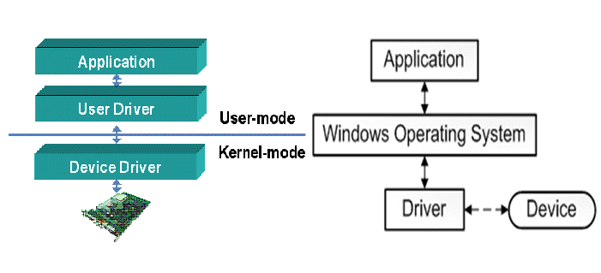
Team A
Hasanova Firuze
Babayev Mehrali
Kernel and Driver programming in Windows

Slide 2
The Windows kernel is a key program that is crucial for Windows to function. The kernel is the first program to load after the bootloader. After loading, it controls and coordinates every other program and process. The kernel is the bridge between the user and the hardware, it translates user instructions for the hardware and connects them.

Slide 3
The kernel performs key services such as scheduling, launching, and ending processes; and, initializing, running drivers (programs that communicate with hardware), and ensuring that memory is allocated correctly.
The Windows kernel is a hybrid kernel, which means it attempts to combine features and benefits of microkernel and monolithic kernel architectures. The idea is to simultaneously benefit from the performance monolithic kernels provide and the stability that microkernels provide.

Slide 4
The kernel of an operating system implements the core functionality that everything else in the operating system depends upon. The Microsoft Windows kernel provides basic low-level operations such as scheduling threads or routing hardware interrupts. It is the heart of the operating system and all tasks it performs must be fast and simple.
Routines that provide a direct interface to the kernel library are usually prefixed with "Ke", for example, KeGetCurrentThread.

Slide 5
Device Driver
A device driver is a special kind of software program that controls a specific hardware device attached to a computer. Device drivers are essential for a computer to work properly. These programs may be compact, but they provide the all-important means for a computer to interact with hardware, for everything from mouse, keyboard and display (user input/output) to working with networks, storage and graphics.

Slide 6
How Do Device Drivers Work?
Device drivers generally run at a high level of privilege within the operating system runtime environment. Some device drivers, in fact, may be linked directly to the operating system kernel, a portion of an OS such as Windows, Linux or Mac OS, that remains memory resident and handles execution for all other code, including device drivers. Device drivers relay requests for device access and actions from the operating system and its active applications to their respective hardware devices. They also deliver outputs or status/messages from the hardware devices to the operating system (and thence, to applications).

Slide 7
Purpose of Device Drivers
Device drivers are necessary to permit a computer to interface and interact with specific devices. They define the messages and mechanisms whereby the computer (OS and applications) can access the device or make requests for the device to fulfill. They also handle device responses and messages for delivery to the computer.

Slide 8
Types of Device Drivers
Invariably, hardware devices belong to a specific class, such as Bluetooth or 802.11xx wireless networking. Creating any specific device driver starts by working within its class framework. Within that class, a particular type of device, such as Bluetooth audio, keyboards or mice, also falls within a related driver framework. Finally, for a specific individual device, within its class and type frameworks, its actual driver software interacts with that device using its native command set and data handling capabilities, as defined and published by its maker or manufacturer. In addition, device drivers can access physical devices (actual hardware) or virtual devices (emulations of hardware in a software program). The former are called physical drivers and the latter are called virtual drivers.

Slide 9
Device Driver Examples
If you run the driverquery command in Windows inside PowerShell or at the command line, it will produce a list of all device drivers installed on the host computer. For Linux and macOS, running the lsmod command at a command prompt also lists device driver modules. It is not unusual for a typical laptop or desktop PC to list hundreds of device drivers in response. Examining this output provides useful drive information, including module name, driver type and display name used to identify a driver. Here's a brief sample from Windows 10:

Slide 10
Module Name Display Name Driver Type Link Date
============ ====================== ============= ======================
1394ohci 1394 OHCI Compliant Ho Kernel
3ware 3ware Kernel 5/18/2015 5:28:03 PM
ACPI Microsoft ACPI Driver Kernel
AcpiDev ACPI Devices driver Kernel

Slide 11
Device Driver Software
In the early days of programming, device drivers would often be written using assembly language, a low-level language that can access hardware and CPU instructions immediately and directly. Today, most programmers who write device drivers work either in the C or C++ programming language, because it offers excellent access to low-level instructions along with more complex program and data structures. Testing device drivers must incorporate security as well as operational issues. Because such software runs at high levels of privilege, it could lead to system compromise or vulnerabilities on the security side, or outright failure (crashing or freezing) and performance problems on the operational side

Slide 12
To allow driver developers to write device drivers that are source-code compatible across all Microsoft Windows operating systems, the Windows Driver Model (WDM) was introduced. Kernel-mode drivers that follow WDM rules are called WDM drivers.
All WDM drivers must do the following:
Include Wdm.h, not Ntddk.h. (Note that Wdm.h is a subset of Ntddk.h.)
Be designed as a bus driver, a function driver, or a filter driver, as described in Types of WDM Drivers.
Create device objects
Support Plug and Play (PnP).

Slide 13
Support power management.
Support Windows Management Instrumentation (WMI).
Should You Write a WDM Driver?
If you are writing a new driver, consider using the Kernel-Mode Driver Framework (KMDF). KMDF provides interfaces that are simpler to use than WDM interfaces.
Do not write a WDM driver if the driver will be inserted into a stack of non-WDM drivers. Please read the documentation for device type-specific Microsoft-supplied drivers to determine how new drivers must interface with Microsoft-supplied drivers.

Slide 14
There are three kinds of WDM drivers: bus drivers, function drivers, and filter drivers.
A bus driver drives an individual I/O bus device and provides per-slot functionality that is device-independent. Bus drivers also detect and report child devices that are connected to the bus.
A function driver drives an individual device.
A filter driver filters I/O requests for a device, a class of devices, or a bus.

Slide 15
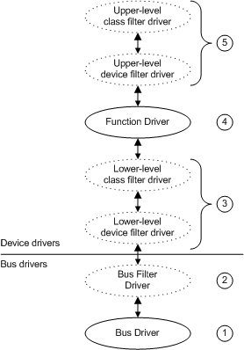
Types of WDM drivers
In this context, a bus is any device to which other physical, logical, or virtual devices are attached; a bus includes traditional buses such as SCSI and PCI, as well as parallel ports, serial ports, and i8042 ports.
It is important for driver developers to understand the different kinds of WDM drivers and to know which kind of driver they are writing. For example, whether a driver handles each Plug and Play IRP and how to handle such IRPs depends on what kind of driver is being written (bus driver, function driver, or filter driver).
The following figure shows the relationship between the bus driver, function driver, and filter drivers for a device.
diagram illustrating possible driver layers.

Slide 16
Kernel-Mode Driver Components
This section introduces the standard routines contained in kernel-mode drivers. Some of these standard driver routines are required; others are optional. The section also introduces driver objects, which contain pointers to each driver's standard routines.
Some drivers interact with a system-supplied port driver or class driver that defines much of the driver's required functionality. For example, a SCSI miniport driver primarily interacts with the SCSI port driver. For such drivers, see the class-specific documentation for details of required and optional driver support.

